Slide 1
ECE 105: Introduction to Electrical Engineering
Lecture 11
Bio 1
Yasser Khan
Rehan Kapadia

Slide 2
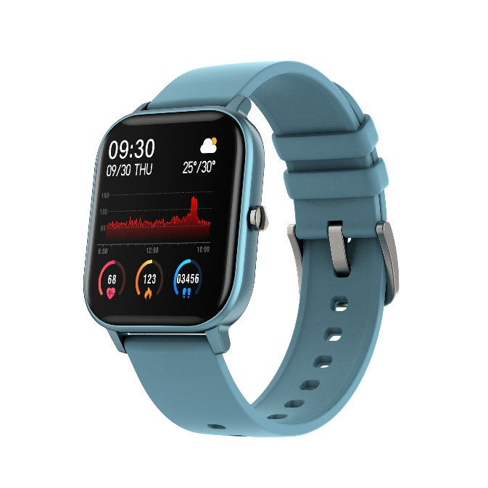
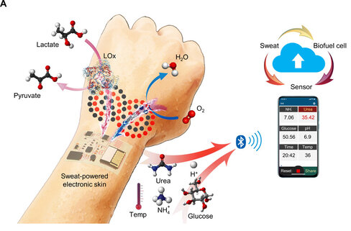
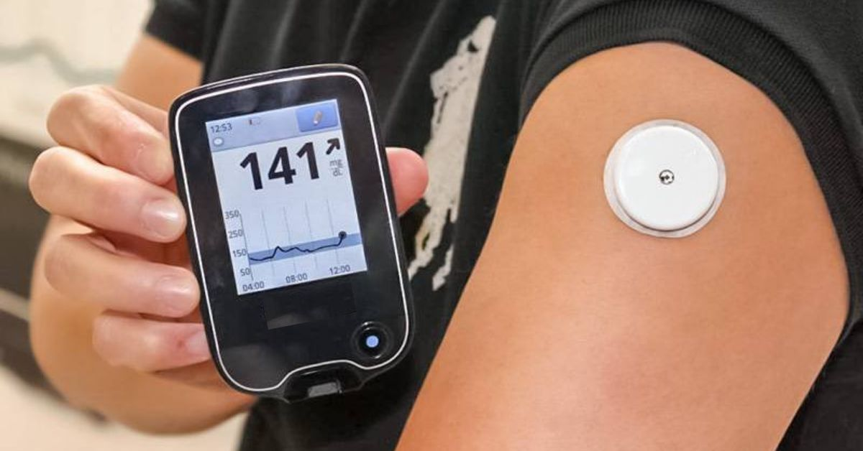

Wearables
Wearables include devices for communication, health, fitness tracking, etc.
Future generations of devices will have new capabilities (therapeutic, haptic, etc.)
New functionality depends on energy harvesting, conformal contact, etc.
Wireless communication essential for most important functions (interfacing to mobile devices, etc.)

Slide 3
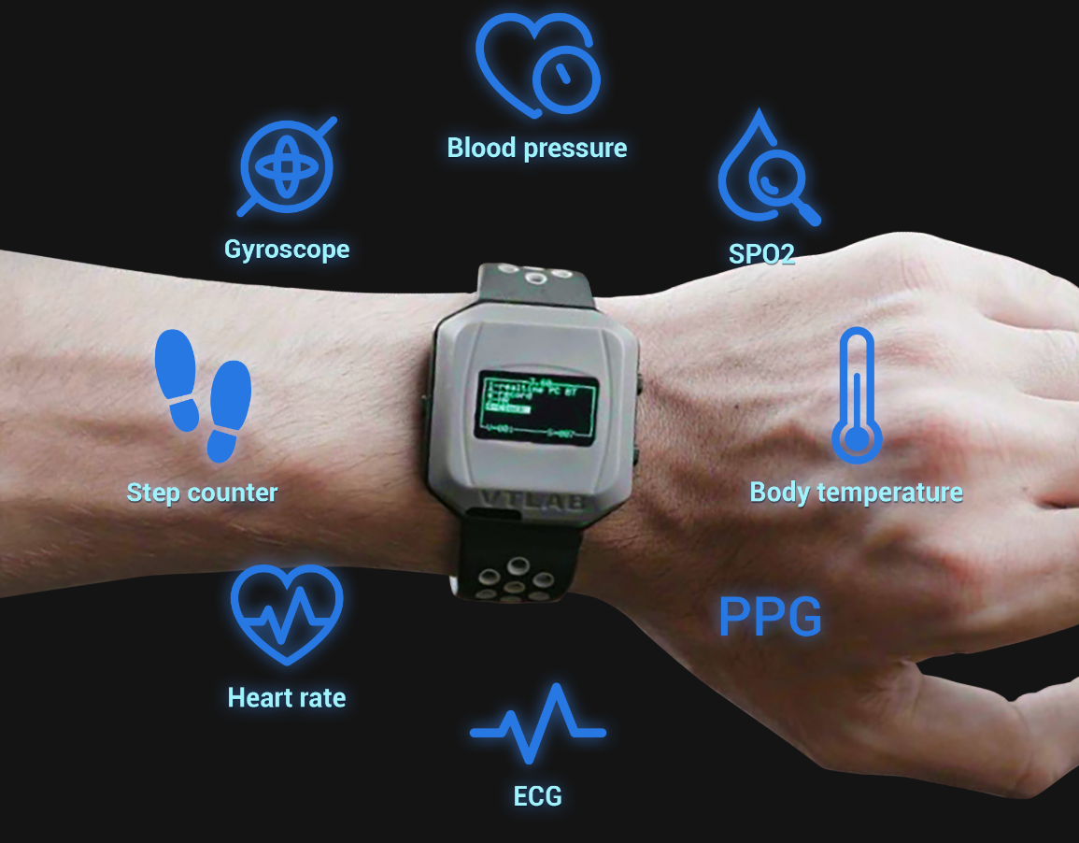
Vital signs
Vital signs include Heart Rate, Blood Pressure, Breathing Rate, Temperature
Attractive for daily monitoring
Combining all of these metrics is more useful for preventive care

Slide 4
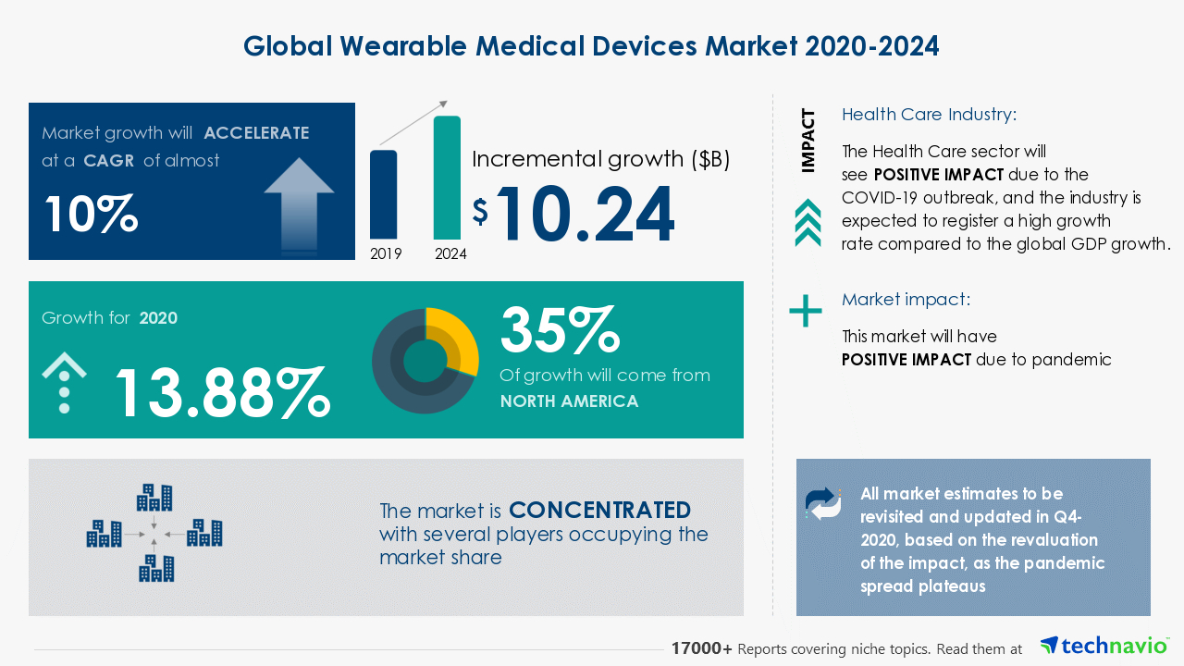
$380.5 billion by 2028 – wearables alone

Slide 5
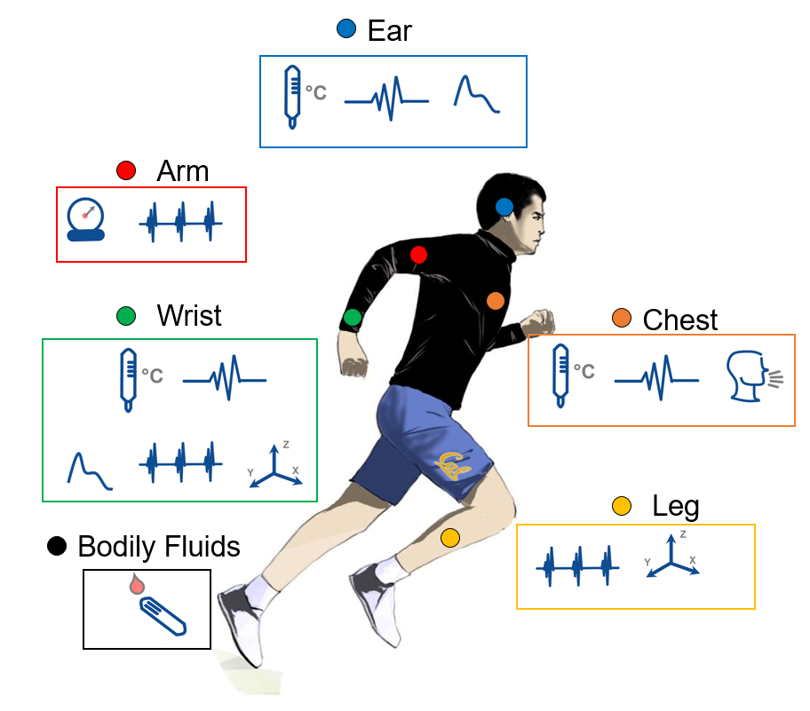
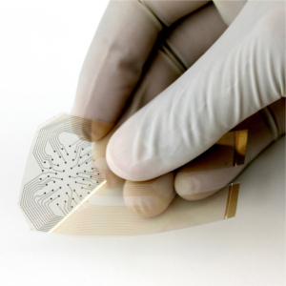
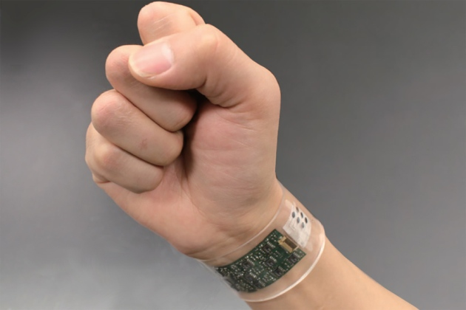
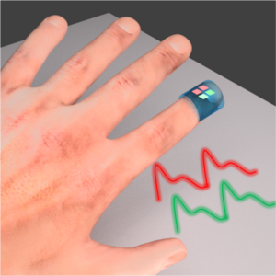
Wearable sensing
Types of wearable sensing
Bioelectronic – ECG, EMG, bioimpedance tomography
Biochemical – Sweat sensing
Flexible sensors can efficiently measure vital signs, and other biosignals from various parts of the body.
Biophotonic – Pulse oximetry

Slide 6
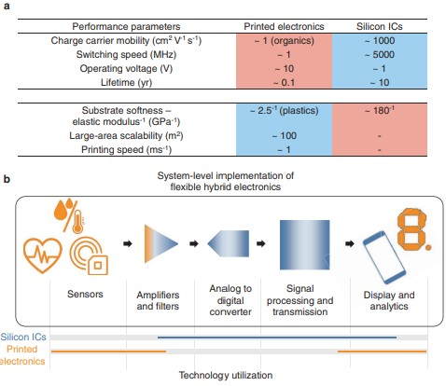
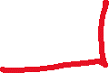
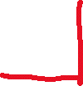
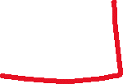
Different parts of a bioelectronics system

Slide 7
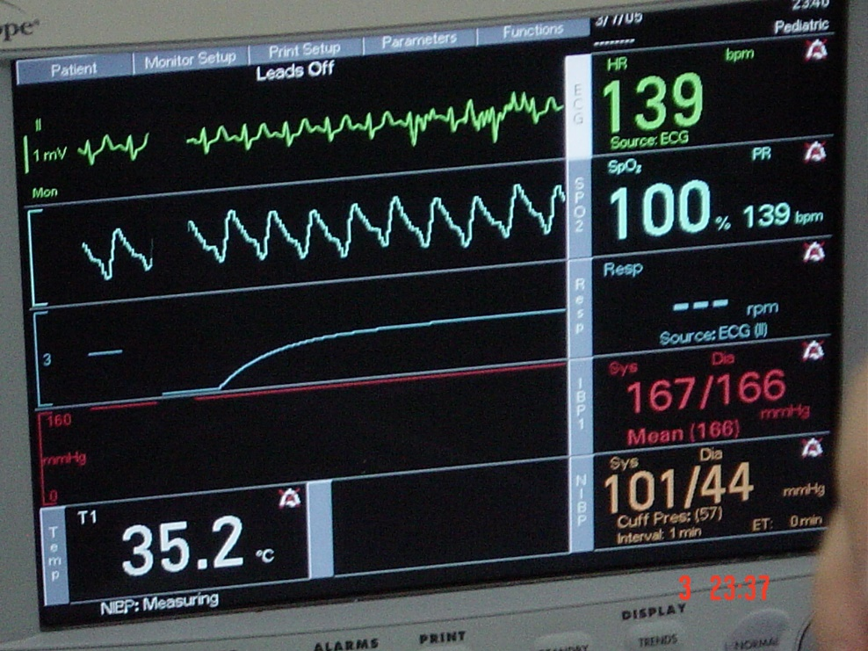
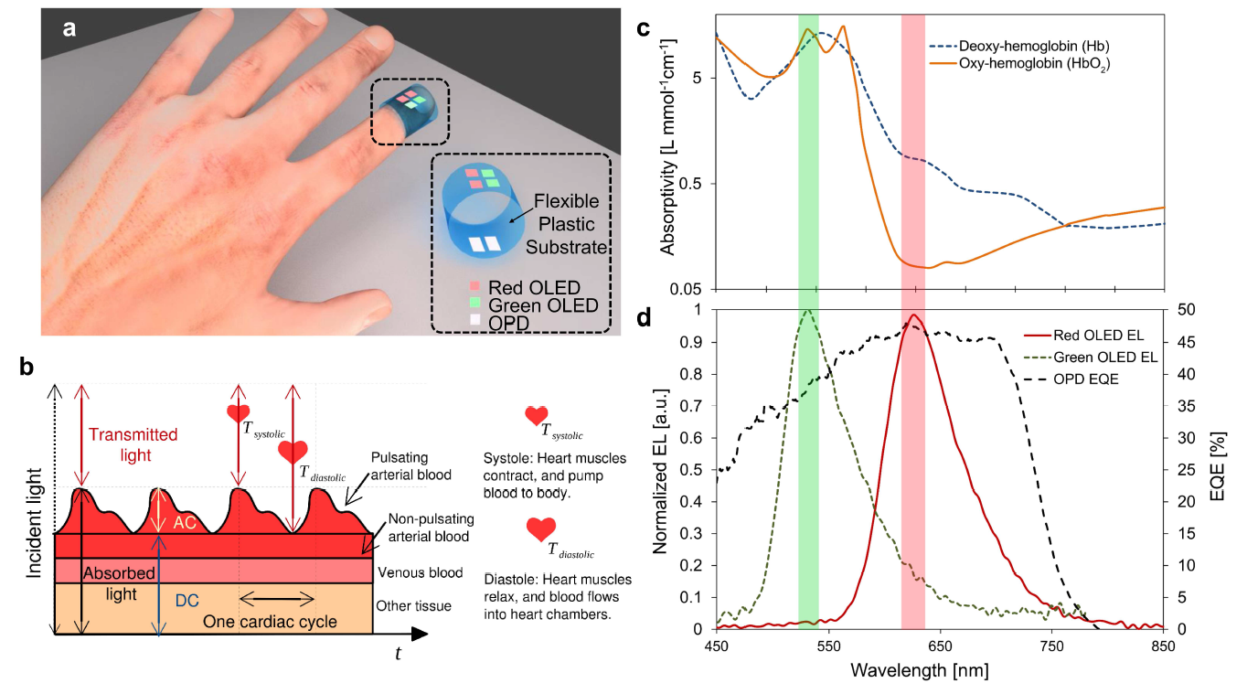
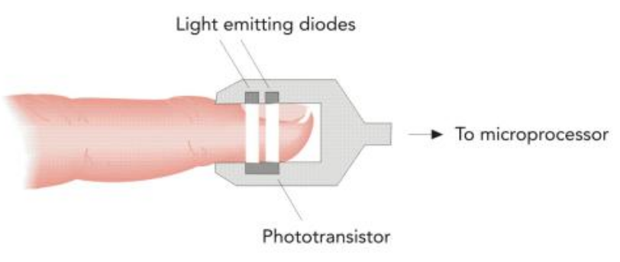
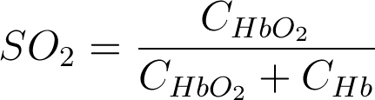
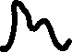
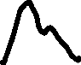
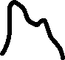
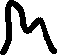
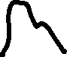
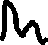
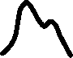
Pulse oximetry
ECG
Pulse oximetry measures blood oxygenation. Using spectrophotometry of absorptivity of blood at two distinct wavelengths, blood oxygen saturation is quantified.
Can detect hypoxemia, ie. lower than normal blood oxygenation.
Pulse Ox
Respiration
Blood
Pressure
Temperature
SO₂ The saturation of oxygen in blood,
C_{HbO2} Concentration of oxygenated hemoglobin (HbO₂),
C_{Hb} Concentration of deoxygenated hemoglobin (Hb).

Slide 8
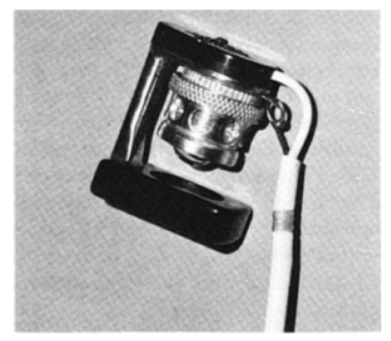
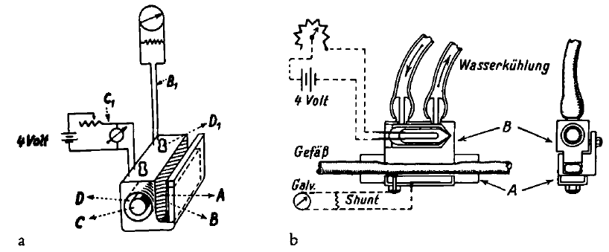
Oximetry - History
1864, The discovery that the colored substance in blood was the carrier of oxygen was made by George Gabriel Stokes (1819-1903)
1935, Kurt Kramer (1906-1985) showed that the Lambert-Beer law applied to hemoglobin solutions and approximately to whole blood, and measured saturation by the transmission of red light through unopened arteries.
1942, Glenn Allan Millikan (1906-1947) built a light-weight ear "oximeter“ during World War II to train pilots for military aviation using a mercury vapor light, yellow and purple filters, and a copper oxide photocell.
1935
1942
1864

Slide 9
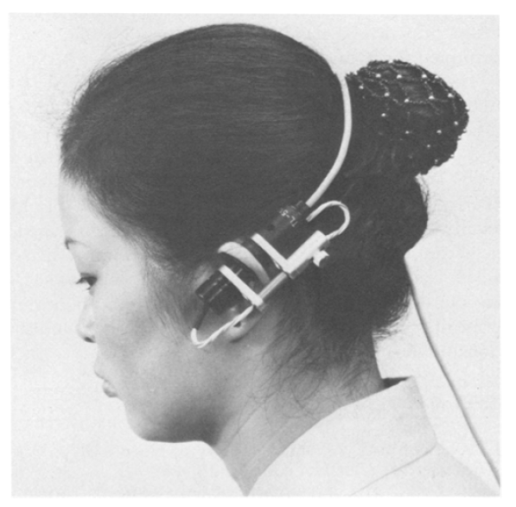
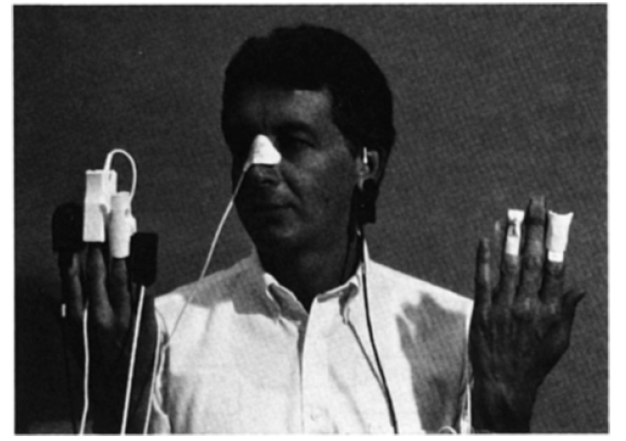
Oximetry - History
Around 1964, Robert Shaw, a surgeon and inventor in San Francisco, began design and construction of a self-calibrating, eight-wavelength ear oximeter. His concept was to uniquely solve the simultaneous equations by using one more wavelength than the number of separate forms of hemoglobin needing identification.
1975, Pulse oximetry was reported by Nakajima, Hirai, Takase, Kuse, Aoyagi, Kishi, and Yamaguchi of the Minoha Corporation. They used fiberoptic bundles to conduct light to and from a finger. Initially the main problem was extreme sensitivity to motion.
Solid state pulse oximeter "probes" on typical locations. Ohmeda Company, Boulder, CO.
1935
1942
1975
1864
1964

Slide 10
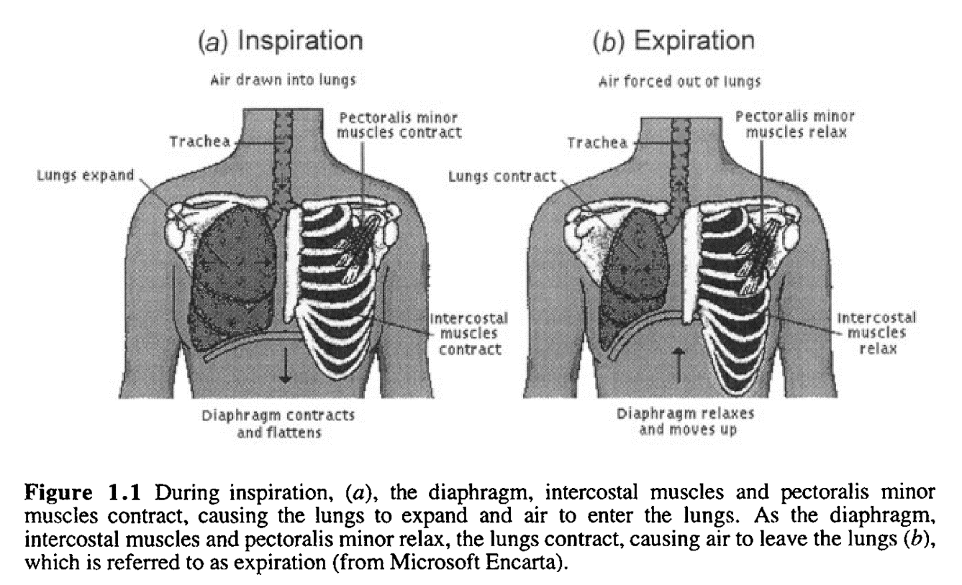
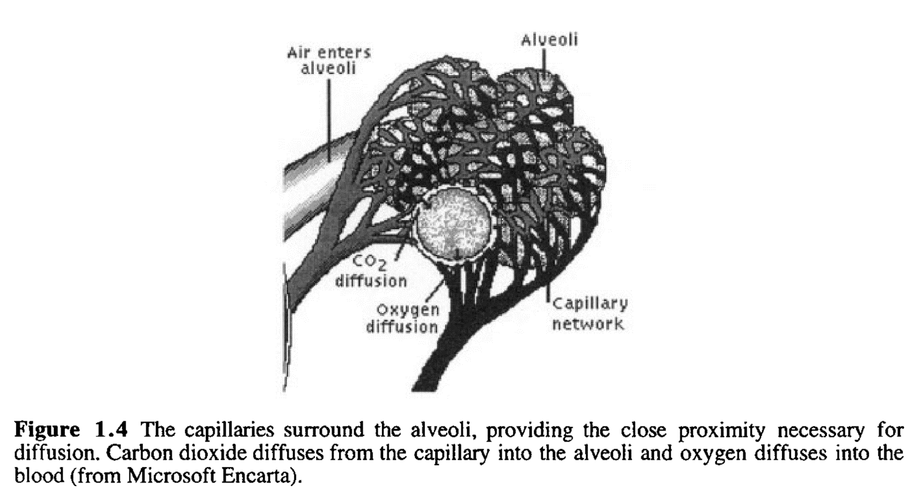
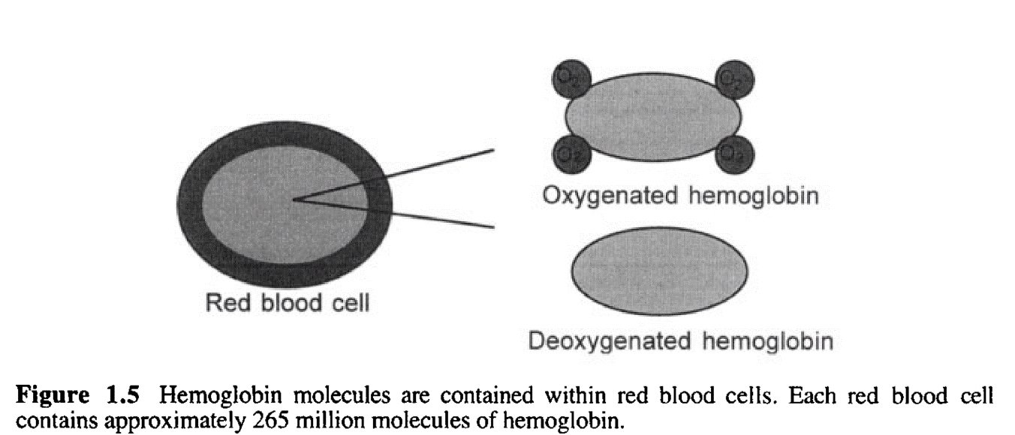
Pulse oximetry basics

Slide 11
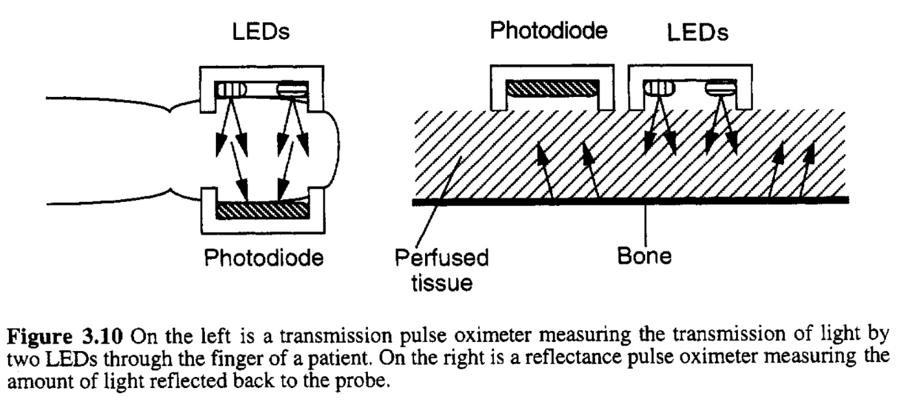
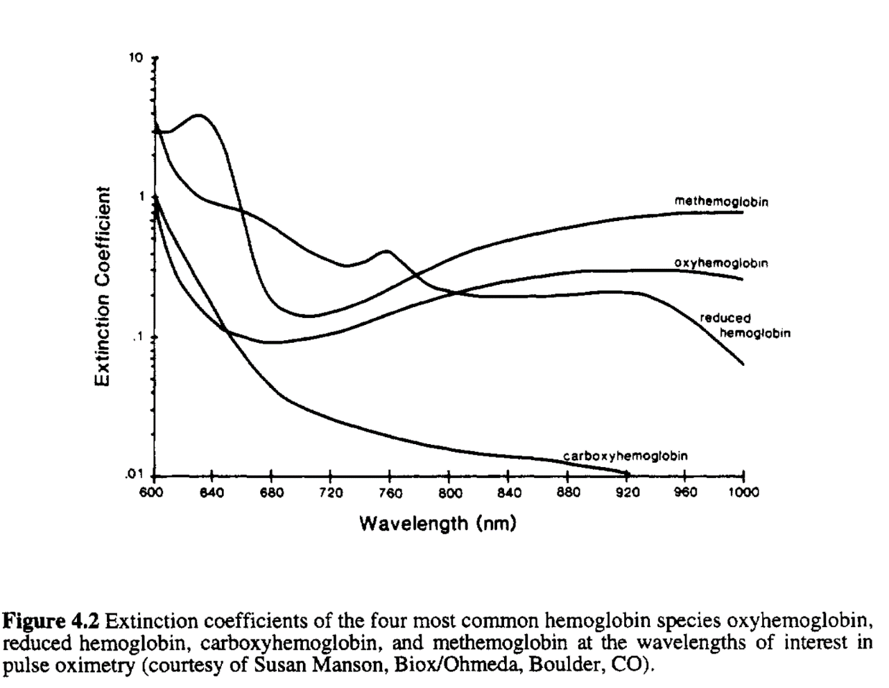
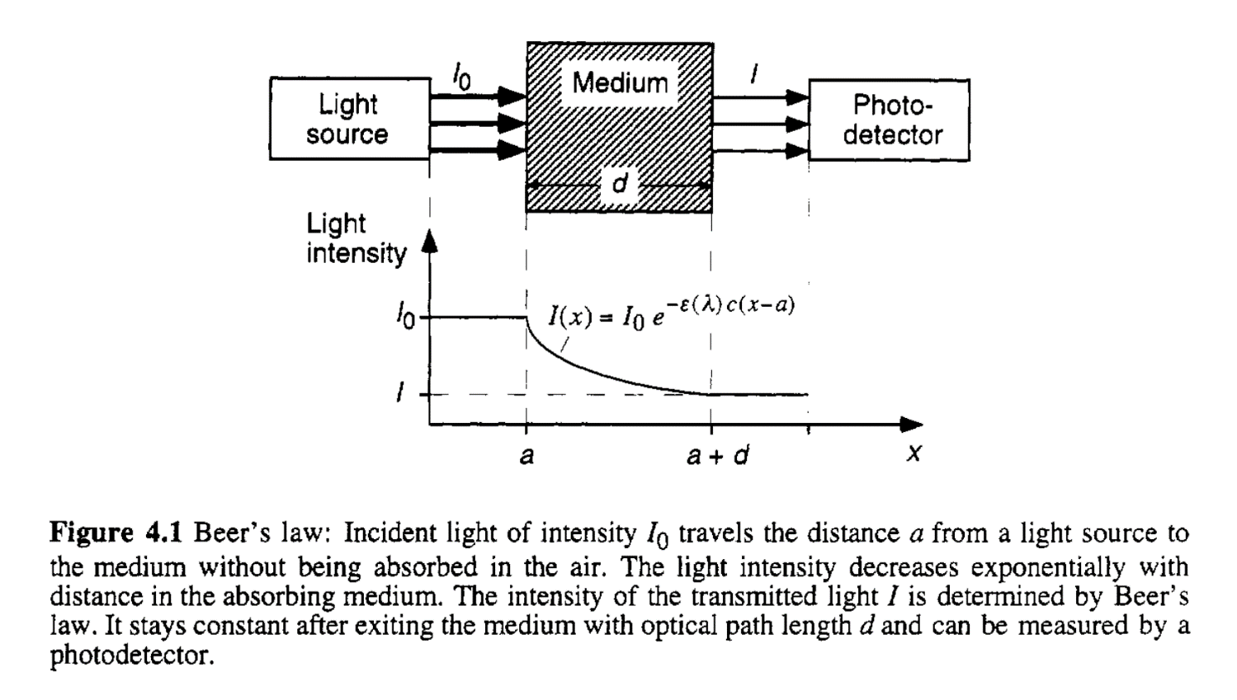
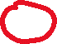
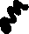

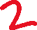


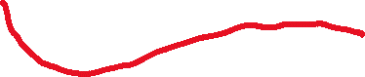
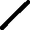


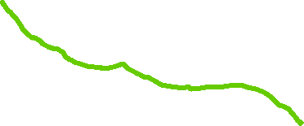

Pulse oximeter basics

Slide 12
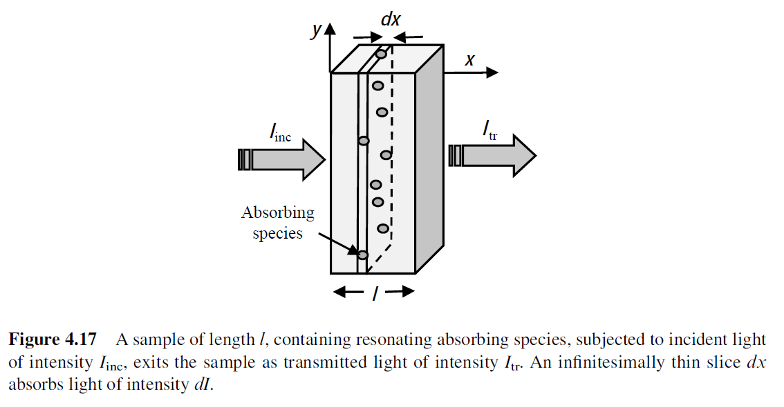
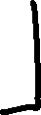
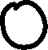
The Beer-Lambert Law

Slide 13
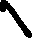
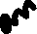
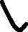
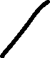
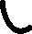
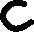
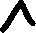







The Beer-Lambert Law

Slide 14










Example 1

Slide 15








Example 1

Slide 16







Pulse oximeter basics

Slide 17









Pulse oximeter basics

Slide 18

Calculating oxygen saturation

Slide 19

Oximeter readout circuit

Slide 20





Oximeter readout circuit

Slide 21


Transmission vs. reflectance oximetry
Transmission-mode pulse oximetry is limited only to tissues that can be transilluminated, such as the earlobes and the fingers.
If reflected light is used as the signal, the sensor can be used beyond the conventional sensing locations.
AC signal is the highest at the forehead for both Red and NIR channels.
Arms provide mid-range AC amplitude, while signal strength is low in the legs and chest area.
Forehead is the best location for reflectance pulse oximetry.

Slide 22

Collect PPG signal

Slide 23

Upload ard code

Slide 24


Open python IDLE – open python file

Slide 25

Open main.py

Slide 26


Run module

Slide 27

Type in which port – check where your Ard in connected

Slide 28

Command – m3ppg

Slide 29

Opens a recording window

Slide 30

Press capture

Slide 31


Keep your finger gently on the sensor

Slide 32

Click save – a new file will be saved

Slide 33

Open jupyter notebook select the new csv file – check the raw data on notebook

